Slide 1
Predicting Credit Card Loan Defaults
Will Tseng

Slide 2
Problem
$764 billion total US Credit card debt (2017 Q2)¹
¹ New York Fed Consumer Credit Panel/Equifax
Notes:
There is currently around 764 billion of credit card debt as of 2017 Q2

Slide 3
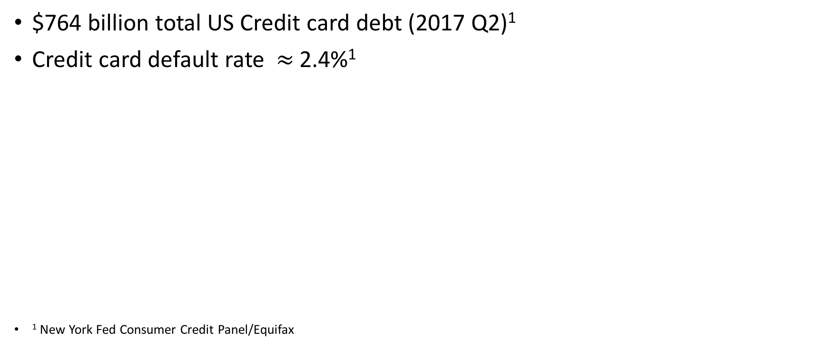
Problem
$764 billion total US Credit card debt (2017 Q2)¹
Credit card default rate $≈$ 2.4%¹
¹ New York Fed Consumer Credit Panel/Equifax
Notes:
There is currently around 764 billion of credit card debt as of 2017 Q2
Though credit card default rate aren’t super high relative to the past it has been increasing for the past 4 years. And its currently at around 2.4%

Slide 4
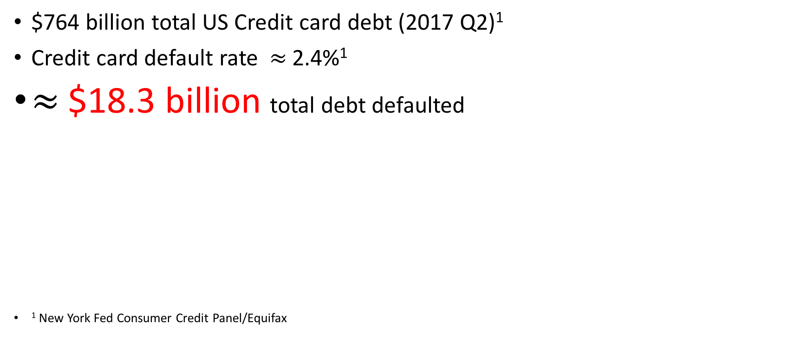
Problem
$764 billion total US Credit card debt (2017 Q2)¹
Credit card default rate $≈$ 2.4%¹
$≈$$18.3 billion total debt defaulted
¹ New York Fed Consumer Credit Panel/Equifax
Notes:
There is currently around 764 billion of credit card debt as of 2017 Q2
Though credit card default rate aren’t super high relative to the past it has been increasing for the past 4 years. And its currently at around 2.4%
which makes that number around $18.3 billion defaulted.

Slide 5
How can we predict credit card defaults and what are its strongest predictors?

Slide 6
Data
30,000 data points of credit card clients payment history and default outcomes in Taiwan from April 2005 to September 2005.
Notes:
So I was able to acquire some data from the UCI Machine learning data repository.
Its basically the a person’s basic account info, payment status and history for the duration of 6 months
Whether they defaulted in the following month October 2005

Slide 7
Data
30,000 data points of credit card clients payment history and default outcomes in Taiwan from April 2005 to September 2005.
6636 default observations (22.12%)
Notes:
So I was able to acquire some data from the UCI Machine learning data repository.
Its basically the a person’s basic account info, payment status and history for the duration of 6 months
Whether they defaulted in the following month October 2005
So in other words, our baseline accuracy score, when we predict everyone to default, is 22.12%

Slide 8
Features
Notes:
So before going into the model, lets take a quick look at some of the features I included in the first model.

Slide 9
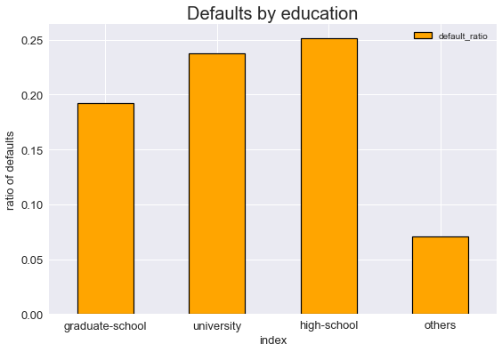
Features
Notes:
First, in general we believe that people who have have higher degrees tend to make more money and in turn their likelihood
of defaulting are less that people with high school degree.

Slide 10
Features
Notes:
And people who have higher credit limit balance are associated with less default and this make sense because if you have a high credit limit,
it means that you have a good credit history and are less likely to default. If you look carefully, the occurrence of default for those with cb 1 std above mean are
Associated with less defaults. So this might be an interesting variable to put in our model

Slide 11
Features
Notes:
But most importantly, we also want to take a look at your payment status history. You can see here that being late is correlated with more defaults.
The more late you are the more interest you accrued, the even less likely you’ll be able to pay.
And if you take a look this number really starts to jump up at around 2month as percentage of default increase from around 34% to over 50%

Slide 12
Model
Features : is_graduate limit_bal num_late
target: is_default
Notes:
And testing with multiple classifiers.

Slide 13
First round model performances
Classifier | Accuracy | Precision | Recall
Naïve Bayes | 0.798 | 0.60 | 0.33
KNN | 0.797 | 0.60 | 0.31
Logistic | 0.757 | 0.47 | 0.59
SVM | 0.798 | 0.60 | 0.33
Bootstrapped Tree | 0.732 | 0.44 | 0.66
Notes:
We can see that the accuracy score has much increased, and we are able to catch 30 something percent of defaulters.
(switch) And we can see that Bootstrapping the decision tree yielded the best model in terms of recall. The model is catching around 66% of all defaulters

Slide 14
First round model performances
Classifier | Accuracy | Precision | Recall
Naïve Bayes | 0.798 | 0.60 | 0.33
KNN | 0.797 | 0.60 | 0.31
Logistic | 0.757 | 0.47 | 0.59
SVM | 0.798 | 0.60 | 0.33
Bootstrapped Tree | 0.732 | 0.44 | 0.66
Notes:
We can see that the accuracy score has much increased, and we are able to catch 30 something percent of defaulters.
(switch) And we can see that Bootstrapping the decision tree yielded the best model in terms of recall. In other words, the model is catching around 66% of all defaulters
But, I think we can do much better than this, so we are going to do more feature engineering because

Slide 15
More feature Engineering
Payment status itself not informative enough
Notes:
So what does that mean? Although being late is a good indicator, what we would I think be more important is to see whether a person was able, through time, pay off what they spent money on (aka. his bill). Because people default because they have a bill they cant pay off.
So how can we get such measure?

Slide 16
More feature Engineering
Payment status itself not informative enough
More important: a person’s ability to pay
Notes:
So what does that mean? Although being late is a good indicator, what we would I think be more important is to see whether a person was able, through time, pay off what he spent money on (aka. his bill). Because people default because they have a bill they cant pay off.
So how can we get such measure?

Slide 17
Feature Engineering (cont.)
gap_{i} = bill_amt_{i} – pay_amt_{i}

Slide 18
Feature Engineering (cont.)
gap_{i} = bill_amt_{i} – pay_amt_{i}
gap_mean = average of the gaps

Slide 19
Feature Engineering (cont.)
gap_{i} = bill_amt_{i} – pay_amt_{i}
gap_mean = average of the gaps
gap_std = standard deviation of the gaps

Slide 20
Feature Engineering (cont.)
gap_{i} = bill_amt_{i} – pay_amt_{i}
gap_mean = average of the gaps
gap_std = standard deviation of the gaps
late_sudden_large_gap = have gaps 0.7 SD above gap mean AND late payment status last 2 months
Notes:
So what this is indicating is whether a person has a history of accumulating relatively larger bills they’ve not paid off
and have a late payment history in August and September.
So the 0.7 is an arbitrary threshold I picked just to define relatively larger bills, any number can do, but 0.7 worked well for me.
And it my training set itself, more than half of those who defaulted possessed this trait. This is to say that although not everyone who
possess such trait is going to default, but defaulters are likely to have such characteristic.
So lets look at our second attempt in modeling

Slide 21
Second Model Performance Comparison
Classifier | Accuracy | Precision | Recall
Naïve Bayes | 0.798 | 0.60 | 0.33
KNN | 0.797 | 0.60 | 0.31
Logistic | 0.757 | 0.47 | 0.59
SVM | 0.798 | 0.60 | 0.33
Bagged Tree | 0.732 | 0.44 | 0.66
Classifier | Accuracy | Precision | Recall
Naïve Bayes | 0.779 | 0.52 | 0.51
KNN | 0.800 | 0.63 | 0.34
Logistic | 0.743 | 0.46 | 0.61
SVM | 0.774 | 0.51 | 0.51
Bagged Tree | 0.704 | 0.42 | 0.71
Notes:
Comparing the old model on the top with our new model on the bottom,
we can see that although our precision has gone down in most cases, our we are catching proportionately
Much more defaults as seen by the recall
While the bootstrapped tree classifier seems to be catching the most defaults, the support vector machine and naïve bayes
have the most balanced recall to precision ratio
So depending on your strategy, the bootstrapped tree is a much more aggressive in trying to prevent defaults, at the cost of
extending loans to people you could potentially make interest out off, while they naïve bayes and SVM is much more moderate. And you can actuallyvisualize this tradeoff ….in the

Slide 23
Takeaways
Be wary of people who have consistently been late for at least 2 months on their payment

Slide 24
Takeaways
Be wary of people who have consistently been late for at least 2 months on their payment
Be wary of large bills that are not paid off

Slide 25
Takeaways
Be wary of people who have consistently been late for at least 2 months on their payment
Be wary of large bills that are not paid off
But even better look at some metric that takes both into account
Notes:
Take a look at both, because its not really the lateness itself that make people default, its because they have bills they are incapable of paying off.
So complementing that with how late a payment is we get a more holistic picture of each individual’s situation.

Slide 26
Thanks!
Any questions?
github: willtseng12

Slide 27
Appendix Regression Diagnostic

